Slide 1


Proposal for
Exceptional Vehicle Management System
March 2019

Slide 2



Requirements
CONTENTS
1
NTT Data Overview
2
Case Study
3
Our Understanding of Project
4
Proposed Business Solution
5
Proposed Technical Solution
6
Proposed Service Operation Solution
7
Project Management
8
Team Structure
©2019 NTT DATA China Co.Ltd.

Slide 3


01
NTT DATA Overview
©2019 NTT DATA China Co.Ltd.

Slide 4

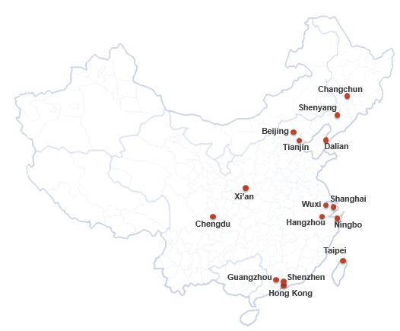
NTT Data Overview
NTT Data Group and NTT Group
(Holding Company)
NTT Data offers full stack, full life cycle IT services, including consulting, across applications, managed service, application maintenance, etc.
We have more than 4000 people in 14 different cities in China.
Revenue*: USD 175 billion
Operating Income**: USD 15 billion
Global Presence: 89 countries & regions
Employees: 283,000 worldwide
Network Coverage: 190+ countries & regions
Subsidiary Companies: 922 worldwide
Data as of March 31, 2018
Note: *Revenue of JPY 11,799.6 billion and Operating Income of JPY 1642.8 billion converted to USD by NTT Group
©2019 NTT DATA China Co.Ltd.

Slide 5
























NTT DATA Group
NTT DATA Global Competitiveness
SAP
CRM
Salesforce.com
Oracle
BI & BA
10+years experiences
400+ skilled
consultants
3500+global clients
3000+counltants
8 global BI centers
9000+SAP Prof.
Multichannel customer experience
2200+projects
50 certified specializations
3000+professionals
60+RDS Solutions
Specialized methodology
Balanced Global Delivery
6 advanced specializations
130+scientistss
Mobility
Cloud
QA & QT
AMO
BPO
？
Strategic offerings
45+ years of knowledge
Constitutes 30% NTT DATA overall revenue
25 delivery centers in 13 countries
Private clouds
APP development
hybrid clouds
End-to-end test management expertise
50+ clients
Mobile Infrastructure
24*7
Test automation tools
40 global service
centers
Cloud SOC
7000+professionals
AMO
©2019 NTT DATA China Co.Ltd.

Slide 6
02
Case study
©2019 NTT DATA China Co.Ltd.

Slide 7

Case Study 1 – Technical Publish Tools
Online view and download the repair documentation for each dealer user
Client | Daimler BMBS – Technical Publish Tools System
Challenge | TPT System provides online repair documentation for each dealer user；and supports 1000 plus dealer users preview at same time; the dealer user has 5000 plus to use this system. All of the document have high security requment ，so the system requires strict security management to maximize control information leakage. The system has the function for the dealer users can contact and provide the suggestion to admin ；and can share the post-reading knowledge.
Solution | Nginx and Docker are used in the system architecture to achieve load balancing, which increases the access restrictions of dealer users. For security reason, TPT has integrated with MBB to achieve SSO. When the dealer user previews or downloads the document online, the system automatically performs online watermarking on the PDF file to ensure the security of the document. The system implements the BBS function, can review articles online and realize knowledge sharing.
Benefits | Automated deployment and load balancing are achieved through the use of Nginx, Docker and Pipeline tools, reducing system development and operational costs. The system uses PDF watermarking technology to avoid leakage of document information. Dealer users can communicate online in a timely manner. Improve problem solving efficiency and knowledge sharing in real time.
©2019 NTT DATA China Co.Ltd.

Slide 8
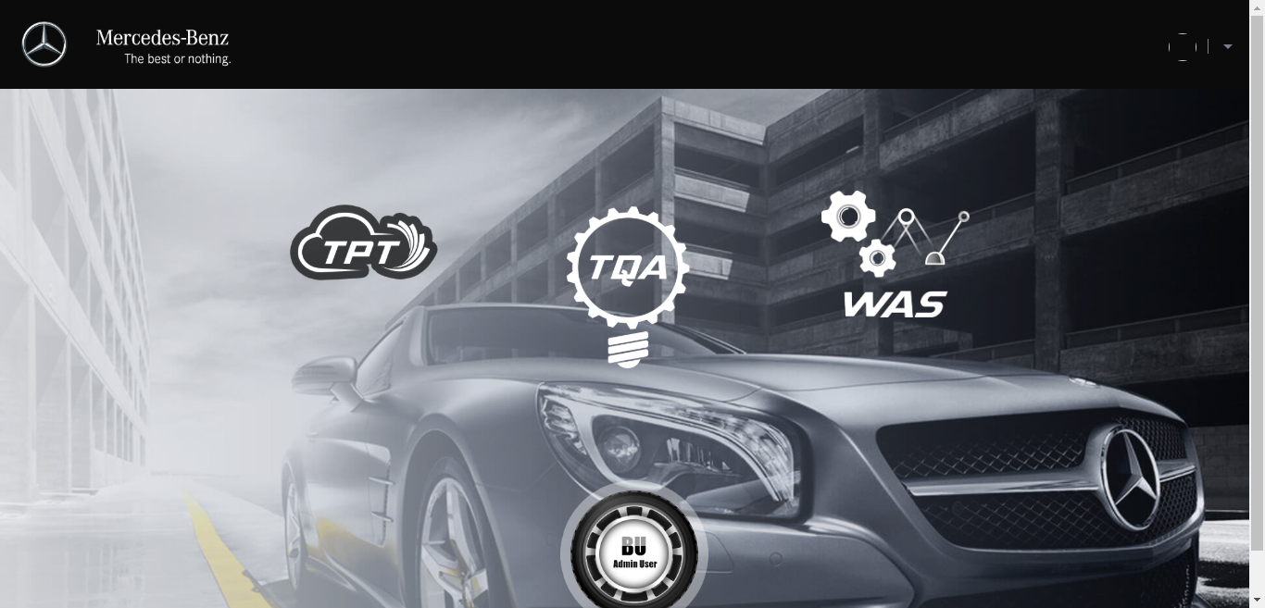
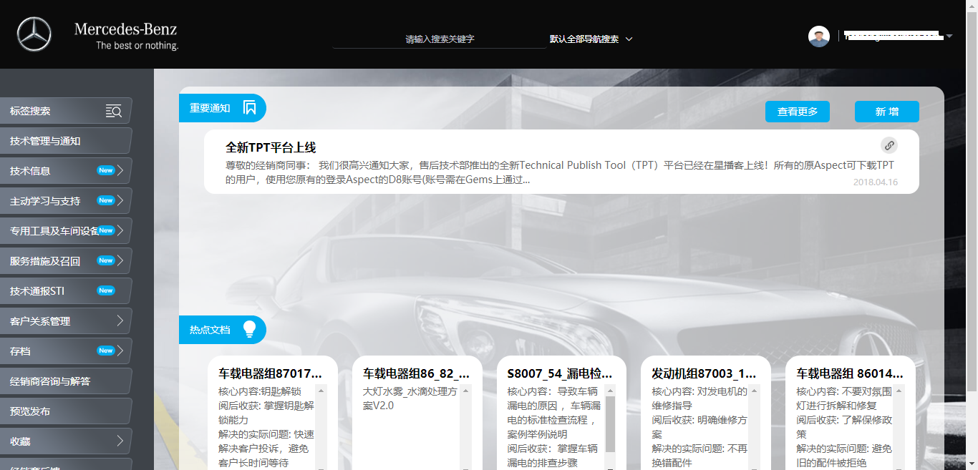
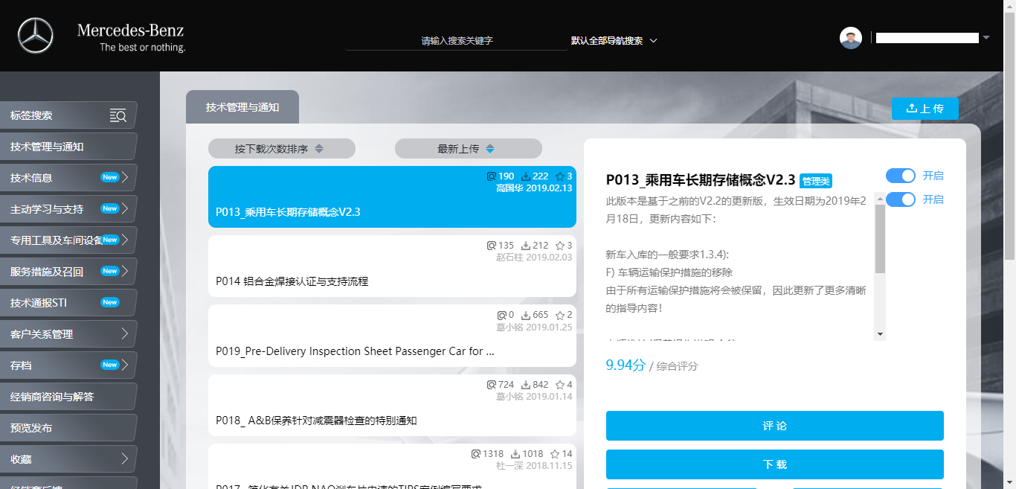
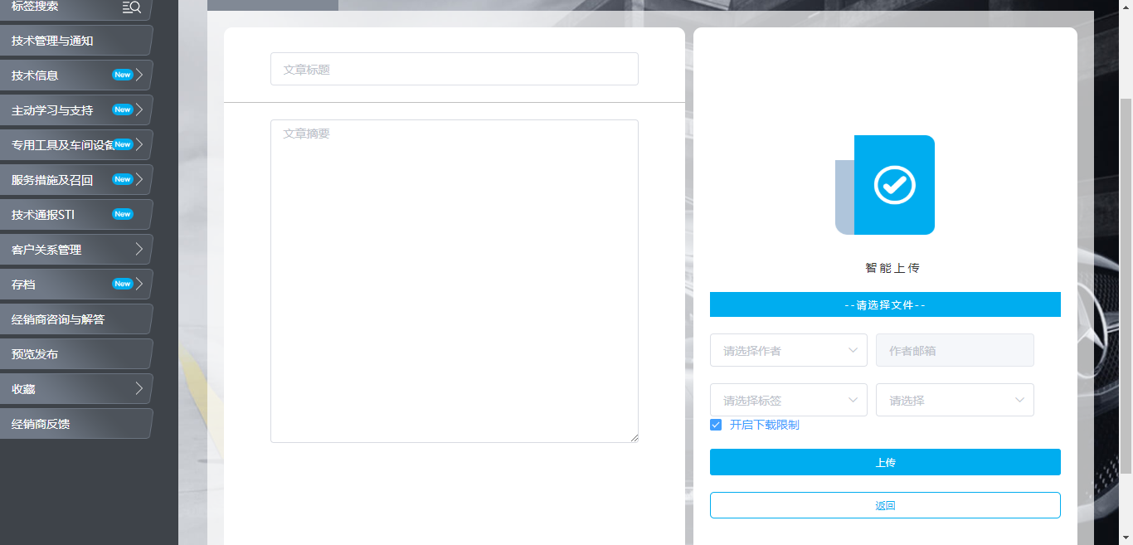
Case Study 1 – Technical Publish Tools
UI/UX experiences in TPT
Login Page
Home Page
List View
Edit Page
©2019 NTT DATA China Co.Ltd.

Slide 9
Case Study 2 – Vending Machine
Using Vending Machine to sell the Daimler premium goods
Client | Daimler BMBS – Vending Machine Platform
Challenge | Daimler‘s sales Dpt. innovatives program promotes premium goods. Use vending machines as a way to expand new retail channels. The vending machine platform can quickly implement innovative solutions and apply them to specific sales processes.
Solution | Daimler WeChat public account as an entrance, through WeChat scanning, through the WeChat public account into the vending machine platform. The vending machine platform realizes the whole sales process of online opening and closing, generating orders and paying at the same time. The Xbatch software development platform was chosen to quickly build project engineering and better match our daimler security strategy. Because this platform is a development platform based on Daimler's ITI security strategy.
Benefits | Through the WeChat public account channel, an automated sales process involving no sales staff was realized. Xbach development platform, which integrates Pipeline, Niginx and Docker, implements rapid construction project engineering and system automation deployment, and integrates related components that meet the requirements of Daimler ITI strategy. As a result, the online time of the project is shortened and the cost of the project is reduced.
©2019 NTT DATA China Co.Ltd.

Slide 10
Case Study 3 – ReMaSys
A professional vehicle remarketing tool for dealers and Daimler employees
Client | Daimler MBAFC – ReMaSys
Challenge | Unfamiliar systems landscape for downstream/upstream interface for Mercedes Benz Daimler China systems.
Solution | Use Figtree as UI development and configuration tool, it is a tool for front-end developing, also support flexible business workflow design Use Sonic MQ as task queues. Use Microsoft SQL Server as database. Use Java to fulfull back-end functions.
Benefits | ReMaSys provide used cars distribution from Mercedes Benz China to dealers and Daimler employees, it has complete business workflow of bidding, it includes process of planning, inspection, pricing, bidding approval and handover, which is similar like EVMS. It supports bidding type of advance auction and tender auction. Through this project, NTT DATA have better understanding of vehicle bidding process, and have good experience of integrate with other Daimler’s system, such as interact with DMS to get repair information of vehicle.
©2019 NTT DATA China Co.Ltd.

Slide 11
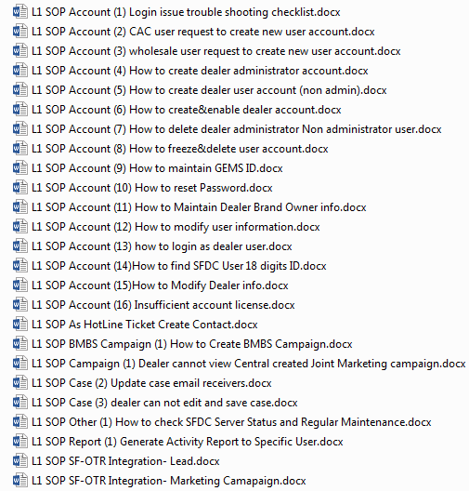
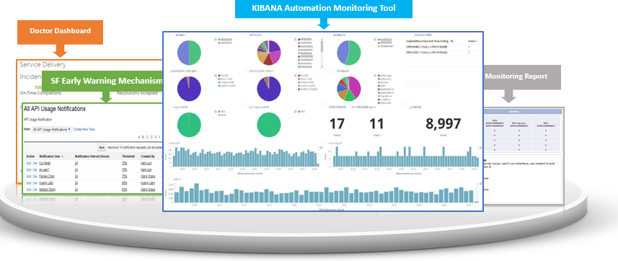
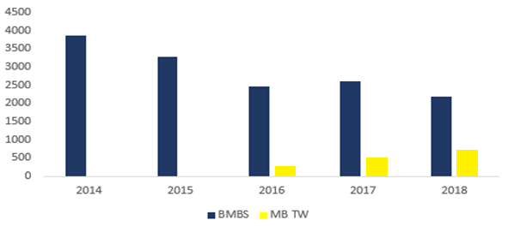
Case Study 4 – CRM Operation
A professional application operation for Daimler CRM
NTT DATA serves Daimler CRM operation since first release in 2013. The service scope is extending supporting BMBS, MB TW together with Daimler business requirement increase. As the team grew capability together with Daimler over years, it gained productivity delivered couples of trainings to service desk
Daimler CRM Operation
SOPs Delivered to Service Desk:
Proficient proactive and automated monitoring toolbox:
Productivity Improvement YoY:
#Volume for yearly trend is not the exact no. due to data privacy concern
©2019 NTT DATA China Co.Ltd.

Slide 12
03
Our Understanding of Project
©2019 NTT DATA China Co.Ltd.

Slide 13

Our Understanding of Project Expectations
Project expectations
Technical Improvement
Business Improvement
Use flexible and advanced technical architecture
Add more flexibility
Add dealer quota management
Add repair history of vehicle, dealer can check it
Better analysis of data
High-quality Operation
Experienced and professional application maintenance services
System stable 7*24
A continual improvement team
A well-managed communication with client satisfaction
Security Fulfillment
Integration With
Existing Daimler System
Pass Daimler security check of EPA and SCAS
System data should be stored in Daimler data center
Make all system users to sign in by IAM.
Integrate with HELM, GSSN, Vehicle Stock Search Service etc.
©2019 NTT DATA China Co.Ltd.

Slide 14
04
Proposed Business Solution
©2019 NTT DATA China Co.Ltd.

Slide 15






Primary System Roles and Access
Category of roles
Dealer
System Admin
Pricing Admin (by brands)
Sales Admin (by brands)
Incentive Controlling Admin
View bidding event and bidding result
Submit price in bidding event
View vehicle list & vehicle detail
View system log
Brand management
Dealer management
Roles management, grant permission & assign brands for roles.
Provide and confirm vehicle’s MSRP in bidding event.
View vehicles under assigned brands
Create bidding event
Upload vehicle’s discount and price information
Select bidding allocation rule
Add / Remove vehicles from bidding event
Publish notification to MBB
Review and confirm bottom price in bidding event.
After bidding event finished, approve adjusted price and adjusted dealer in vehicle detail by sales admin
Logistic Admin (by brands)
Upload vehicle’s damage quotation information
Upload PDI report for vehicles
©2019 NTT DATA China Co.Ltd.

Slide 16
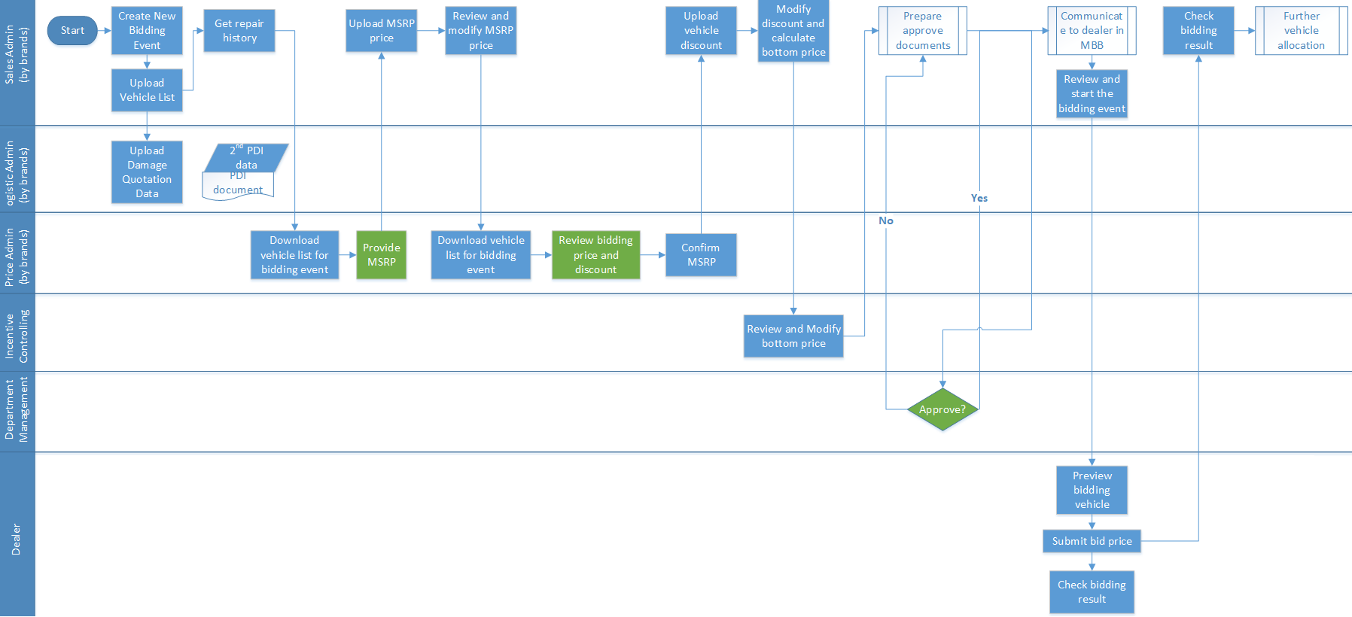
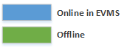
General Business Workflow with Roles
A complete workflow of bidding
©2019 NTT DATA China Co.Ltd.

Slide 17
Functional Modules of EVMS
Function group design for EVMS
User & Permission Management
Bidding Event Management
Report
Dealer Management
User: Create / Update / Delete
Create / View / Update / Delete
Template
Create / Read / Update
GSSN
Roles: Create / Update / Delete
Bidding Allocation Rules Setting
Generate
Brand Assign
Roles: Permission Grant
Download
Brand Management
System Log
Assign Roles to User
Create / Read / Update / Delete
Settings
Login History
User Action History
Email
Vehicle Management
Template
Vehicle Info: Create / Read / Update / Delete
PC: Update
Generate
Authentication
PDI Info: Create / Read / Update
SIC: Update
Login & Logout
IAM
Send
Repair History: Create / Read / Update
EVMS
Vehicle Stock Service
DMS
DMS - DWH
HELM
©2019 NTT DATA China Co.Ltd.

Slide 18
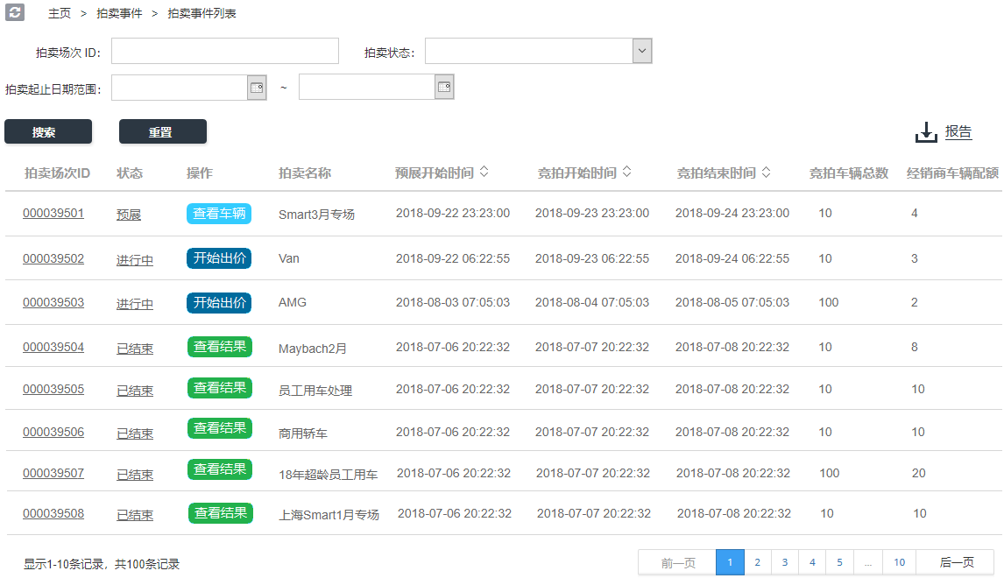
Bidding Event List - Dealer
Dealer can filter list by conditions
Dealer can filter list by status, date duration etc.
Dealer can have a brief view of a bidding event, and do different operation in this view.
©2019 NTT DATA China Co.Ltd.

Slide 19
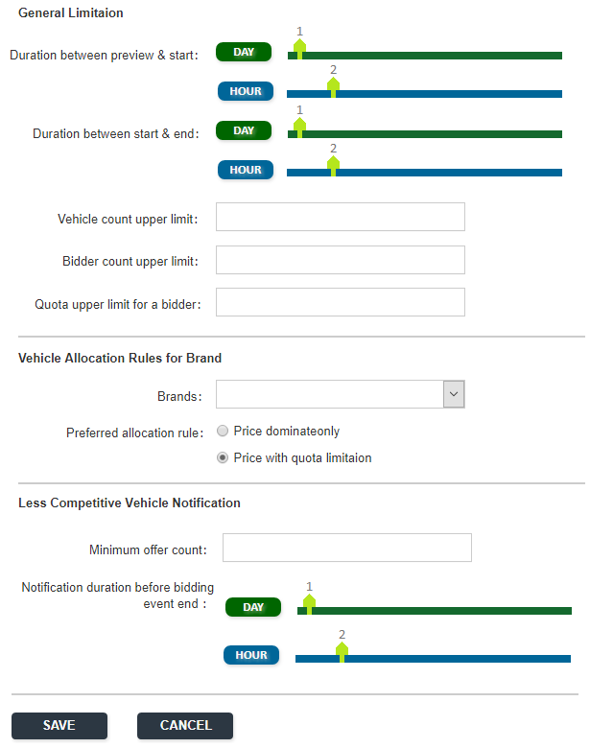
Configure for Bidding Event Creation
Add flexibility of bidding event, for system admin
1. Add count limitation for bidder, vehicles, add time duration configuration etc.
2. Allow different vehicle allocation rules by brands
3. Add flexibility to control less competitive vehicle notification
©2019 NTT DATA China Co.Ltd.

Slide 20
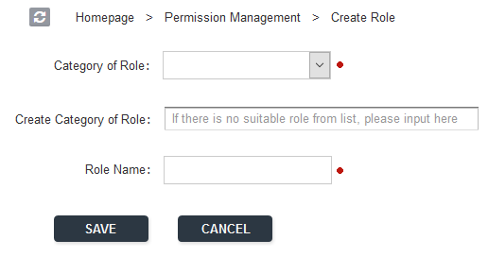
Create Roles
Create role and group of roles.
Create new system role, categorize them by group.
©2019 NTT DATA China Co.Ltd.

Slide 21
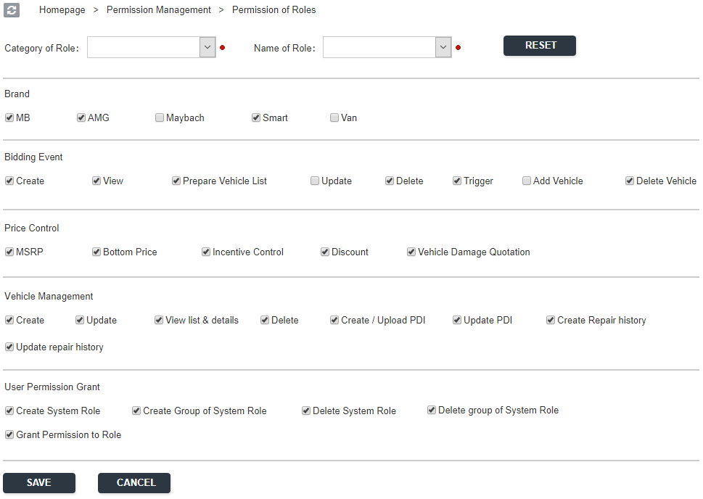
Configure Permission Grant for Roles
Grant permission flexibly
Permission grant for different system roles, all permissions are categorized by group.
Note: not all permissions are listed, in real case, other permission also need to be configured to a dedicated role.
E.g.
System log,
Dealer management ,
Report generate &download etc.
©2019 NTT DATA China Co.Ltd.

Slide 22
05
Proposed Technical Solution
©2019 NTT DATA China Co.Ltd.

Slide 23
Advantages of Solution
The advantages by using microservices based technical solution
Security
Follow Daimler Standards
X-Batch Framework Support
©2019 NTT DATA China Co.Ltd.

Slide 24








Architecture for EVMS
Browser
Daimler ADCC
https
Load Balancer
http
Nginx
Frontend
Web View Layer
Vue
API
Docker Container
Backend
Application API Layer
Spring-boot
Redis
Datasource Pool
DataBase
Data Persistence Layer
©2019 NTT DATA China Co.Ltd.

Slide 25














Solution Pool
Solution pool of NTT platform
Web Layer
API Layer
Springboot
Nginx
Application Layer
ELK
Redis
Grafana
PostgreSQL
Virtualization Layer
Tomcat
Mongo
Open shift
Docker
Ansible
Infrastructure Layer
K8S
©2019 NTT DATA China Co.Ltd.

Slide 26


X-Batch Framework Support
How X-Batch set up microservices in application layer
API Gateway
X-Batch HELM
X-Batch GSSN
X-Batch CDM
EVMS
Monitoring Paltform
API Interface
(REST/SOAP)
API Interface
(REST/SOAP)
API Interface
(REST/SOAP)
API Interface
(REST/SOAP)
…
Business Logic Layer
(Service Component)
Business Logic Layer
(Service Component)
Business Logic Layer
(Service Component)
Business Logic Layer
(Service Component)
Logging Paltform
Data Access Layer
(DAO Component)
Data Access Layer
(DAO Component)
Data Access Layer
(DAO Component)
Data Access Layer
(DAO Component)
Management
Container (Docker)
Container (Docker)
Container (Docker)
Container (Docker)
Container
(Docker)
Container
(Docker)
Cache
Container
(Docker)
Cache
Container
(Docker)
Cache
Container
(Docker)
Cache
Container
(Docker)
DB
Container
(Docker)
DB
Container
(Docker)
DB
Container
(Docker)
DB
Kubernetes/Rancher
IDC
©2019 NTT DATA China Co.Ltd.

Slide 27









NTT Platform Solution Overview
Tool box of NTT platform
Assembly Line
Collaboration
Runtime
GitLab
Jenkins
Cucumber
Nexus
Jira
Confluence
Java
Springboot
Sonarqube
Artifactory
Test Runner
Jira Reports
Trello
Agile
K8S
ReactJS
Middleware
MongoDB
Logging
Grafana
Tomcat
Redis
PostgreSQL
CaaS / PaaS
Infrastructure
Openshift
Docker
Ansible
Azure
AWS EC2
AliCloud
BareMetal
©2019 NTT DATA China Co.Ltd.

Slide 28
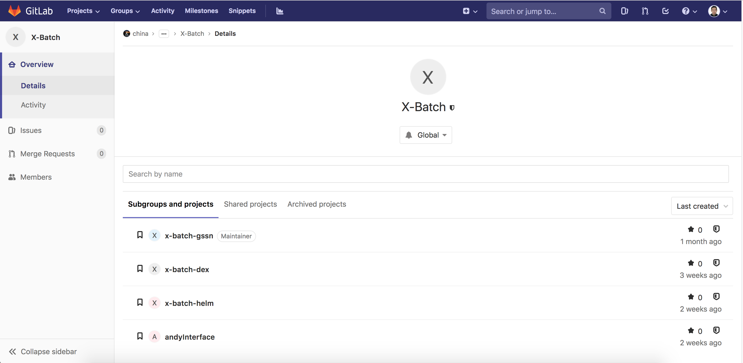
Code Repository
Daimler Gitlab
https://git.mercedes-benz.com/china/its/cd/crm/X-Batch
©2019 NTT DATA China Co.Ltd.

Slide 29













Quality Check – SEE Platform
Daimler SEE Platform
In order to support quality check, the state-of-art software excellence enabler platform that we’re building can be leveraged, The platform
is built to enforce the best engineering practices, improve software quality and provides fast feedback to the development teams.
https://see.mercedes-benz.com.cn/go/
Insights
Quality
Security
Commits history & champion
Best vendors to
keep code quality
Most busy hours during a day
line of method
test coverage
duplication
cyclomatic complexity
soure code
frame
work
system
mobile
max depth
code standards
build
deploy
git.mercedes-benz.com
artifact inventory docker registory
runtime environments

Slide 30
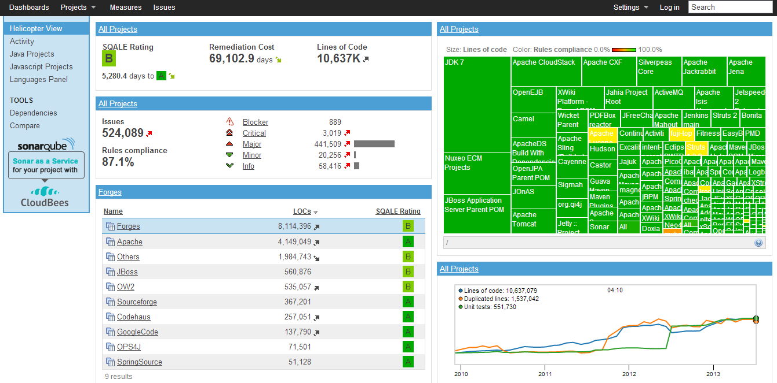
Quality Check – SonarQube
Benifical suppliment of SEE Platform
©2019 NTT DATA China Co.Ltd.

Slide 31
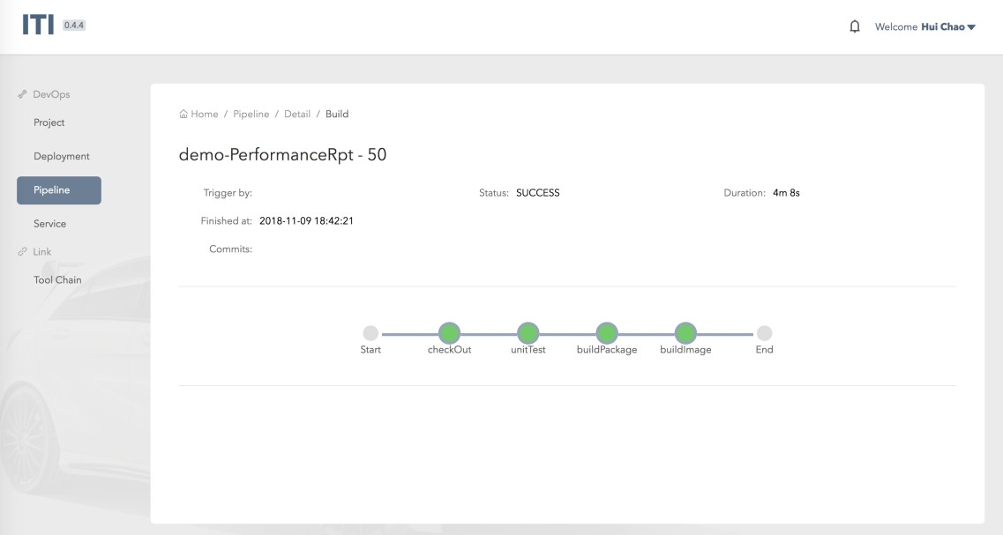
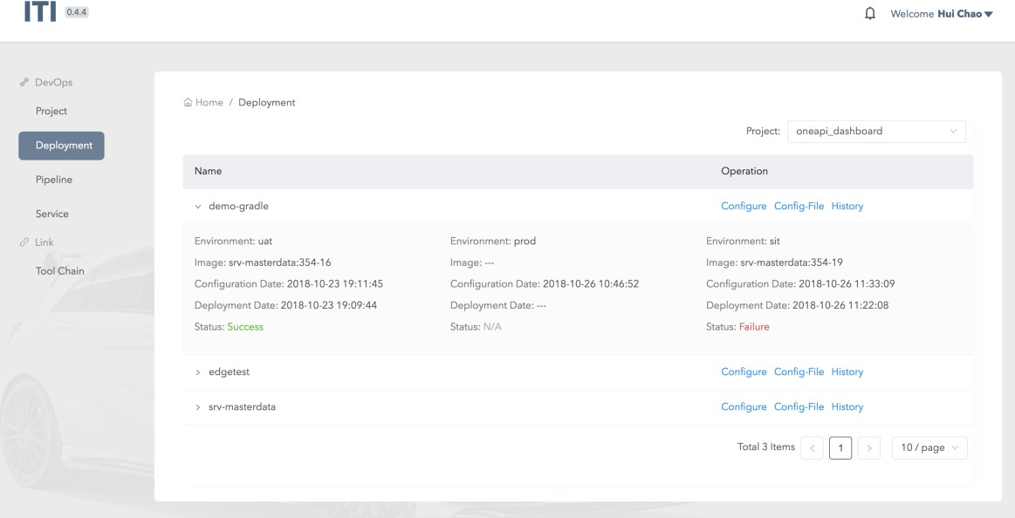
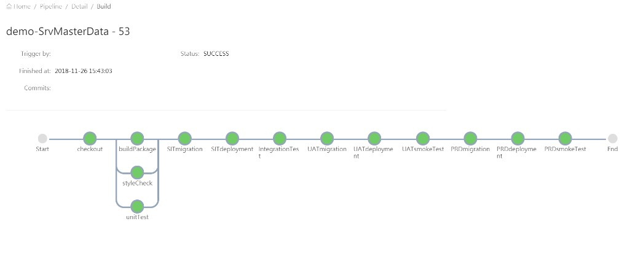
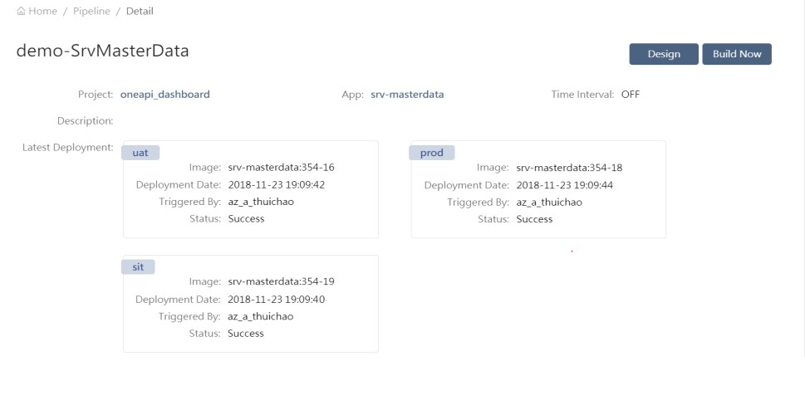
ITI DevOps Platform
Daimler DevOps Platform
ITI is providing DevOps platform for pipeline provisioning and deployment.
©2019 NTT DATA China Co.Ltd.

Slide 32
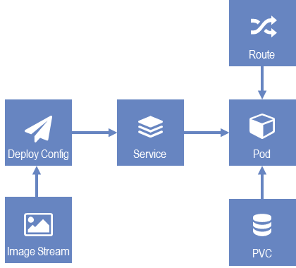
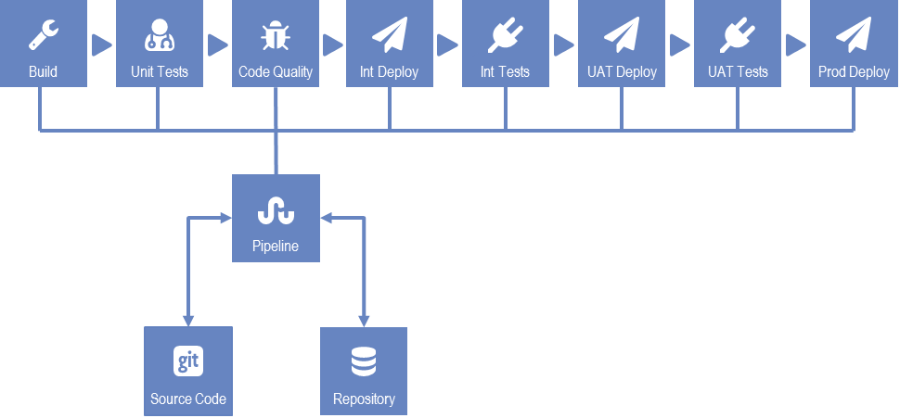
NTT Platform Build Pipeline
Benificail suppliment of ITI DevOps Platform
INT
UAT
PROD
Source Code
Build Pipeline
©2019 NTT DATA China Co.Ltd.

Slide 33







NTT Platform Build Pipeline
NTT platform DevOps platform
Jenkins
9
Build Image
Image
SCM
3
Checkout
Deploy
10
CI
Pod
2
11
System Tests
Trigger Job
INT
Setup CI
Database
4
PROD
1
Build,
Unit Tests
8
Checkin
5
6
Rest API
Archive
Artifacts
Code
Quality
7
Artifactory
©2019 NTT DATA China Co.Ltd.

Slide 34
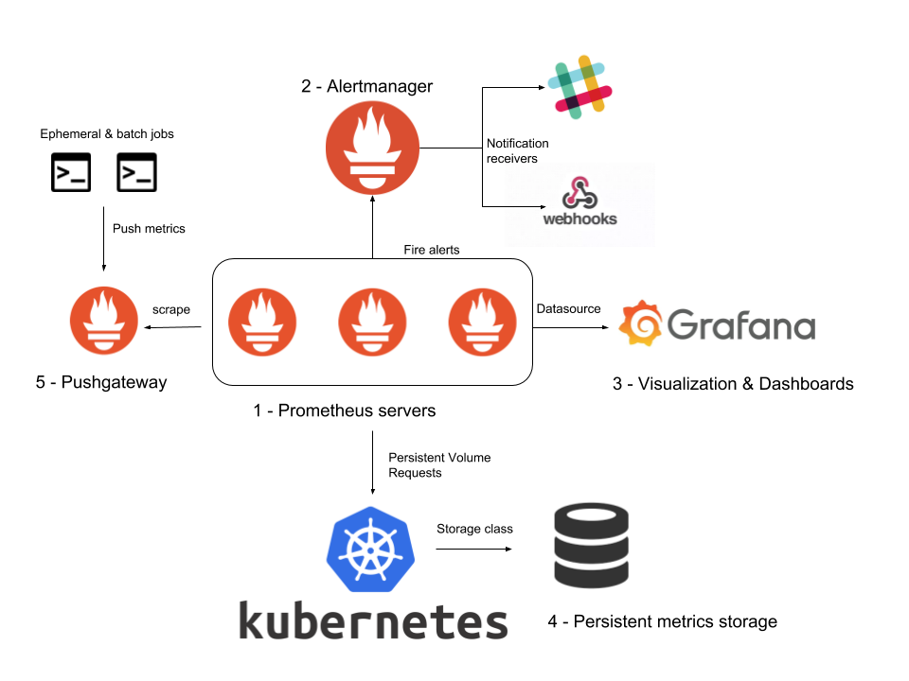
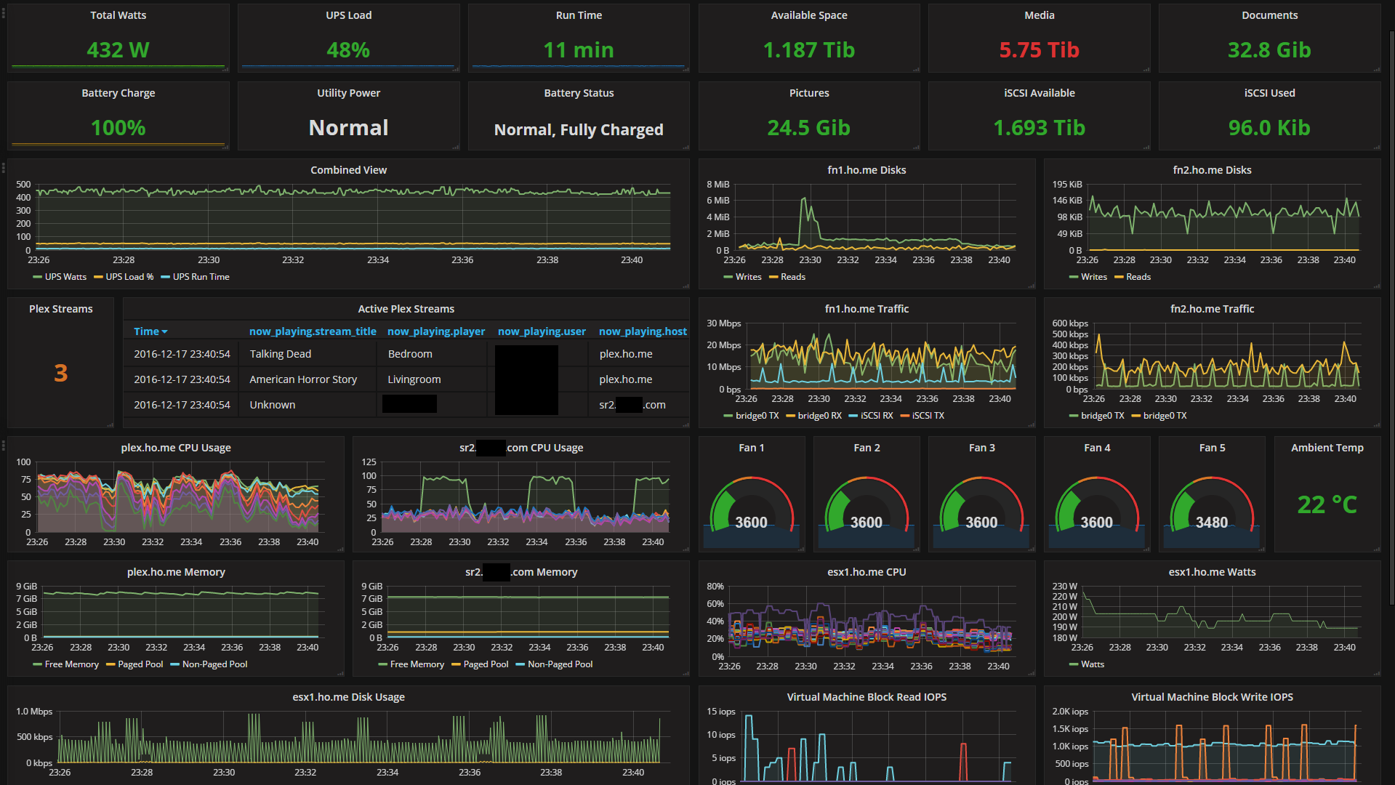
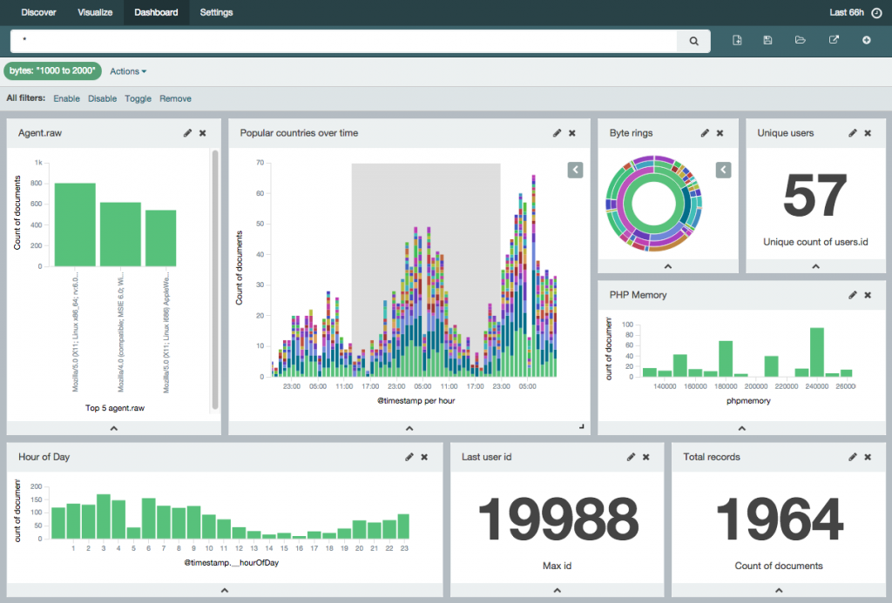
X-Batch Monitoring And Logging Platform
Monitoring And Logging
Monitoring can be done using open-source tools like Prometheus in combination with Grafana by creating gauge and matrices, Kubernetes/OpensShift, Apigee, combined with Grafana.
©2019 NTT DATA China Co.Ltd.

Slide 35
Infrastructure Proposal
Hardware proposal
The table below lists the proposed infrastructure for an environment, e.g. INT environment, we suggest to use same infrastructure for INT / UAT / PROD environment.
Servers | CPU Count | Model Name of CPU | Memory Size | Data Storage Size
Web Server | 2 | Intel(R) Xeon(R) CPU E7-4890 v2 @ 2.80GHz | 8G | 8G /var/log
Application Server | 16 | Intel(R) Xeon(R) CPU E7-4890 v2 @ 2.80GHz | 32G | 100G /var/lib/docker 100G /appdata
Database Server | 4 | Intel(R) Xeon(R) CPU E7-4890 v2 @ 2.80GHz | 32G | 100G /srv/postgresql/data
©2019 NTT DATA China Co.Ltd.

Slide 36
06
Proposed Service Operation Solution
©2019 NTT DATA China Co.Ltd.

Slide 37

Service Operation- Transition
Transition methodology to support a smooth transfer
Stakeholder Kickoff
Draft Document
Completeness
of KT
Sign-off of Transition Phase
Identify Gaps in Workflow Process
Conduct KT Reverse Presentation
KM Training
Start SLA Calibration
Preparation
Knowledge Transfer
Assisted Operation
Stabilization
Steady State
Validate Work Scope
Review Completeness of Documentation
Implement Transition Communication Plan
Stabilization
Project Handover to SO
Identify any knowledge gaps or missing KT items and update KMS Repository
Knowledge Management (On-Going Updates)
Start KM Skill Analysis
KM Environment Setup
Prepare KM Process and User Manual
Complete Work Request with SME guidance
In-Flight Project Assessment
KM Skill Mapping
Stabilization
Assisted Operations
Augment/Enhance KMS Documentation
Re-organize support team structure
Commence reporting
Reverse Presentation
Validate information obtained during KT
Update KMS documents
Perform hands on tasks
Knowledge Transfer
Knowledge Acquisition
Staggered ramp up with trainings within NTT DATA Teams
Begin service delivery in new to-be environment
Establish KMS Repository
Planning & Preparation
Resource Mobilization
Validate Tech Stack and trainings
Decide domains by Wave
Establish Core Team
Steady State
©2019 NTT DATA China Co.Ltd.

Slide 38
Service Operation- Service Delivery Model
An integrated application maintenance service management model to provide optimal service
We will offer:
Change Management
Service Request
Management
A standardized, ITIL based, well-established service delivery model
Change Request
Know-how
DB
Optimal application 2nd and 3rd level support services
Event Management
(Monitoring)
Incident
Management
Controlled Know-how-Transfer
7*24 support services following customer pre-defined SLAs and KPIs
Release Management
Problem Management
Change Request
©2019 NTT DATA China Co.Ltd.

Slide 39


Service Operation- Support Model
A standardized operating model based on Daimler service management practices
Operation Tasks:
Development Tasks:
End User
Data Management: add, modify, delete
Escalation & Progress acknowledge
Event Monitoring
KB maintenance
P1 issue stand-by during off-hours
Continual training to L1 support
Bug identification & fixing
Problem analysis & solutions
Source code optimization for security and vulnerability check
Integration issues
Minor enhancement, change
Testing
Hotline
/Ticket Tool
•
•
•
•
•
•
L1
Service Desk
Ticket Tool
/ Phone for P1
L2
Junior Engineer
Ticket Tool
L3
Senior Engineer
Responsibility Split :
Operation activities are performed by
L2 operation under the conduction of L3 operation
L2 operation also performs as SINGLE POINT OF CONTACT from NTT side, who pulls the updates in NTT organization and acknowledge the progress of issue resolving to service desk
Development tasks are performed by
L3 operation while testing activities can be delivered by L2 under upper level’s conduction
L3 operation also performs as the representative of NTT under the case that cross team (incl. infrastructure, code producer company) technical diagnosis is required
NTT DATA
Ticket Tool
Backend Support
©2019 NTT DATA China Co.Ltd.

Slide 40

Service Operation- Knowledge Management
A predefined knowledge transfer process for a virtuous cycle
Key Activities:
Internal KT for new feature is provided by NTT project team to operation team
L2 operation prepare the new feature’s general introduction and handover to L1 operation as PHASE I KT deliverables
…
Development
Testing
Knowledge
Transfer Process
Deployment &
Service Operation
Testing
Go live
Key Activities:
L1 & L2 operation regular review as-is SOP processing status with Q&A session
L2 operation provide SOP for new features and transfer to L1 team in PHASE II KT session
Key Activities:
L2 operation start monitoring, analyzing new function tickets and prepare new SOP files
NTTDATA Project team
NTTDATA L2 Operation
Daimler L1 Operation
©2019 NTT DATA China Co.Ltd.

Slide 41
Service Operation- Report Portfolio
Report portfolio is provided for a complete operation status monitoring mechanism
Daily
System Availability
Report
SLA/KPI Tracking
Outstanding Tickets Tracking
Weekly
System Availability
Report
Tickets Summary Report
SLA/KPI Tracking
Outstanding Tickets Tracking
Monthly
System Availability , Health check Report
Tickets Summary Report
SLA/KPI Tracking
Outstanding Tickets Tracking
Service Performance Report
Management Committee Report
©2019 NTT DATA China Co.Ltd.

Slide 42
07
Project Management
©2019 NTT DATA China Co.Ltd.

Slide 43

Project Timelines
Timeline for each phase
Phase | Working Day For Each Week
 | 1 Week |  |  |  |  | 2 Week |  |  |  |  | 3 Week |  |  |  |  | 4 Week |  |  |  |  | 5 Week |  |  |  |  | 6 Week |  |  |  |  | 7 Week |  |  |  |  | 8 Week |  |  |  |  | 9 Week |  |  |  |  | 10 Week2 End Year
Scoping
System Proposal
IT Proposal
Implementation
Test Run/ Go-Live User Training
Transition Service Operation
QG PLAN
QG PLAN
QG PLAN
QG PLAN
QG PLAN
QG PLAN
QG PLAN
EVMS Tasks
QAN
Milestone
Note: This is an estimate. It is flexible and can be changed as per Daimler’s requirement.
QG PLAN
Go-Live
©2019 NTT DATA China Co.Ltd.

Slide 44
Project Schedule Activities
Within the scope of this project
Timeline | 1 Week | 2-3 Week | 3 Week | 3-7 Week | 8 Week
Phase | Scoping | System Proposal | IT Proposal | Implementation | Test and Run
Objectives | Validate business and IT requirements Prepare for system design phase | Integrate all defined requirements into the system design | Create proposal for implementation | Set up integration environment | Set up delivery environment
Task | Review existing documents Project setup/kickoff Process mapping to validate (existing business- and IT-requirements) Workshop for business and IT requirements UI/UX design for EVMS Realization planning Refine project plan Document results for quality Gather initial prototype design for EVMS | System design Solution design Data model and attribute definition Use cases description Functional description Clarifying required interfaces Clarifying UI/UX Document results for sign off Prototype building for EVMS Interface building for EVMS | Functional IT-design Logical and physical data modeling Interface contracts Document results for sign off | Development of the integration environment according to the system proposal Connect interface Test and delivery Document results for sign off Build final EVMS prototype (Prod) Design Test/ UAT EVMS | Testing software including all processes, interfaces, and functionalities by the key user Functional test of interfaces Go-Live production environment Document results for sign off Go-Live
©2019 NTT DATA China Co.Ltd.

Slide 45
Project Schedule Activities
Within the scope of this project
Timeline | 1 Week | 2-3 Week | 3 Week | 3-7 Week | 8 Week
Phase | Scoping | System Proposal | IT Proposal | Implementation | Test and Run
Methods/ Approach | Interviews / Meeting Process mapping Data Validation | Interviews/Meeting Adjusting | Interviews/Meeting Adjusting | Programming | Testing methodology Adjusting/fine-tuning
Milestone | Validate IT and business requirement Define Project Plan, fix next steps Set up project management | Validate system proposal Sign-off EVMS Specifications Begin EVMS Prototype build | Validate IT system proposal and IT architecture Feedback EVMS prototype Lock down EVMS Changes | Validate Integration environment Deliver EVMS Final Prototype (Prod version) | Go-Live
©2019 NTT DATA China Co.Ltd.

Slide 46
Assumptions and Dependencies
Our understanding for assumptions
Assumptions and Dependencies on Daimler
Purchase order should be ready no later than Apr.1st, 2019.
BRD of EVMS should be frozen no later than Apr.1st, 2019.
Daimler should provide standard and crteria of quality gate.
Daimler should provide accounts of Git.
Daimler should provide platform of DevOps.
Daimler should provide hardware and instruments for INT / UAT / production environment, relative hardware of jump machine, and relative accounts to access those environment and jump machine.
Our assumption for UI / UX design is: it could be frozen within two releases.
©2019 NTT DATA China Co.Ltd.

Slide 47
08
Team Structure
©2019 NTT DATA China Co.Ltd.

Slide 48
Team Structure of Project and Support
Team structure with head count
Dealer
Daimler
Project Manager
Product Owner
IT Specialist
/Architect
Responsible for other Systems
Dealer 1
Dealer 2
NTT DATA
1
2
1
1
1
Project Manager
BA
UI/UX Designer
Architect
Operation Manager
2
4
2
3
Front-end Developers
Back-end Developers
Tester
Operation Engineer
©2019 NTT DATA China Co.Ltd.

Slide 49
Profiles of Resource Candidates
Profiles of resources
Role | Name | Skill | Work Year
Project Manager | Vincent Miao | Excellent in project management methodologies, especially in software development process of agile and waterfall, familiar with IT architecture and delivery process of Daimler, familiar with CICD methodologies. | 10
Architect | Fei Cao | Excellent in Java, PostgreSQL, MySQL, VUE, Docker Linux etc. Familiar with CICD methodologies, familiar with software development process of agile and waterfall. | 12
Business Analyst | Wayne Bai, Xin Tian | Familiar with Axure, Sketch, Visio etc., familiar with methodologies of product management, product prototype design, and business workflow design. | 10
Sr. Developer (Back-end) | Yi Li | Familiar with Java, Redis, Nginx, PostgreSQL, and web programming. | 10
Sr. Developer(Back-end) | Bin Li | Familiar with Java, PostgreSQL, Docker, Linux OS, and web programming. | 6
Sr. Developer(Back-end) | Linwei Yang | Familiar with Java, PostgreSQL, Docker, Linux OS, and web programming. | 8
Developer (Back-end) | Wentao Bai | Familiar with Java, PostgreSQL, Docker, Linux OS, and web programming. | 3
Sr. Developer (Front-end) | Zhihua Zhang | Familiar with framework of VUE and ReactNative, and web programming. | 6
Sr. Developer (Front-end) | Yingbo Zhang | Familiar with framework of Bootstrap and VUE, familiar with MySQL, Linux OS and web programming. | 6
Sr. UI Designer | Jeff chen | Excellent in user interaction design and visual design, familiar with Photoshop, Sketch and Illustrator. | 6
Sr. Tester | Jianglian Ni | Excellent in testing methods, theory and test management tools, familiar with design test plan and functional / performance test cases according to requirements. | 8
Operation Manager | Grace Wang | Excellent in service operation management through HD to L3 operation, transition and transformation. Familiar with ITIL methodologies and Daimler service delivery model. Good skills on multilateral communications and project management. | 8
Junior Support Engineer | Jack Yuan | 3 years+ application maintenance experiences in auto industry, familiar with operation processes, good skills on DB operation, familiar with Linux OS, Java, Docker. | 5
Junior Support Engineer | Cliff Zhao | 5 years+ application maintenance experiences in IT industry, familiar with web services, operation processes, ITIL foundation certificated. | 5
Sr. Support Engineer | Wen Qi | Excellent in Jave and database programming, Linux OS, web programming, familiar with frontend framework, good knowledge on GIT. | 6
©2019 NTT DATA China Co.Ltd.

Slide 50
Q & A
Let’s start the journey together!
March 2019

